Slide 1
BitBuddy
By group BitByBit

Slide 2
Problem space
Students lack affordable, accessible academic support
Private tutoring is too expensive for many families
Learning help is not available instantly when needed
Social media dominates student attention buts adds low educational value
Current platforms fail to engage students effectively
Notes:
The main problem is that many students can’t access affordable tutoring, while also spending a lot of time on social media. At the same time, existing learning platforms aren’t engaging enough. So there’s a clear gap for something that is both accessible and designed around how students already use technology.

Slide 3
Business Model
Target: Secondary school students (UK)
Affordable AI + tutor support (freemium to subscription)
Low startup costs (~30k-75k)
Recurring revenue model (subscriptions)
Break-even at ~600-1,200 users
High scalability (low cost per extra user)
Revenue potential (96k-960k/year as users grow)
Future B2B school partnership for stability
Notes:
Bit Buddy targets secondary school students in the UK by offering an affordable combination of AI support and human tutor verification, using a freemium model that encourages users to upgrade to subscriptions.
From a financial perspective, the business is highly viable due to its relatively low startup costs, estimated between £30,000 and £75,000. The subscription model creates consistent, recurring revenue, which makes income more predictable as the user base grows.
We estimate breaking even at around 600 to 1,200 paying users, which is realistic given the size of the student market. Because this is a digital platform, it is highly scalable, meaning the cost of serving additional users is very low while revenue continues to increase.
This creates strong revenue potential, ranging from around £96,000 to nearly £1 million annually as the platform expands. In the future, partnerships with schools will provide a more stable and reliable income stream.
Overall, Bit Buddy combines affordability, scalability, and recurring revenue, making it a financially strong and sustainable business model.

Slide 4
Team
Fatima Nasir Ahmed
Keiko Azka
Max Millian Marty
Temisere Presely
Jeshurun olaide
Notes:
Our team is well-suited to deliver this project because we combine both technical development and security expertise.
With four computer science members, we have the skills needed to design and build a scalable, user-friendly platform, including the app, AI integration, and overall system performance.
Our two cyber security specialists ensure the platform is safe and secure, which is especially important as we are working with students and handling personal data. They focus on data protection, user safety, and safeguarding compliance.
This balance of development and security allows us to not only build Bit Buddy effectively, but also ensure it is trustworthy, reliable, and suitable for a young audience.
Overall, our team has the right mix of skills to successfully develop, launch, and grow this platform, turning the idea into a secure, scalable, and real-world solution.

Slide 5
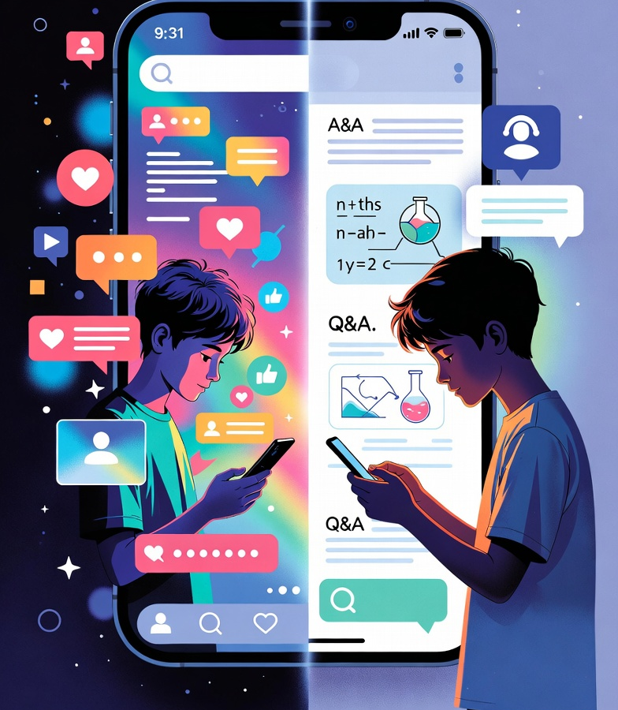
Turning Scroll Time into Study Time
“A platform that feels like social media but works like a classroom.”
Notes:
Bit Buddy takes something students already use every day and transforms it into a powerful tool for learning.

